Slide 1

SATIRE IN MASTER AND MARGARITA
Satire is a type of writing that uses sarcasm and irony to expose society’s and people’s
VICES
FOLLIES
STUPIDITIES
ABUSES
The Faust works we have read all contain a mixture of raucous comedy, satire and tragedy. Bulgakov’s M&M follows this tradition. It contains 2 types of satire: moral satire and comic satire.

Slide 2
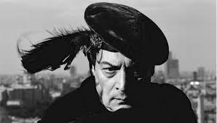
THE FOCUS OF BULGAKOV’S SERIOUS MORAL SATIRE: SATAN’S (WOLAND’S) JOB

Slide 3
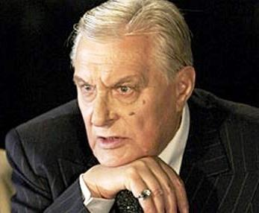
Woland’s (the Devil’s) job is to roam the world, locating, tempting, taunting, and punishing sinners. He is both whistle-blower and enforcer. He represents justice that is fair, but merciless, zero-tolerance justice.
The most terrible vices get the worst punishments and are generally treated seriously, punished by
death and non-being (Berlioz),
loss and suffering in life (the Master, Margarita),
1000 years of guilt and remorse (Pilate).
The petty sins and ordinary “human” foibles are treated comically, and the punishments, though often frightening, are of relatively short duration, and reversible.

Slide 4
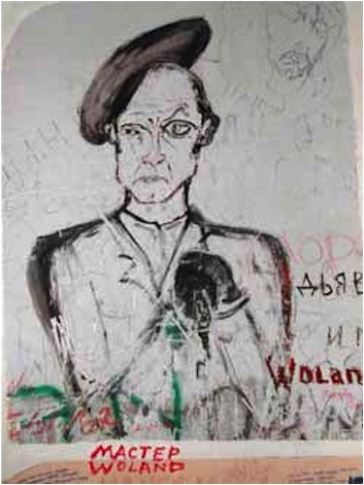
WHO MAKES WRITTEN PACTS WITH THE DEVIL?
Graffito depicting Woland, drawn on the walls of 302B Sadovaya Street in Moscow

Slide 5
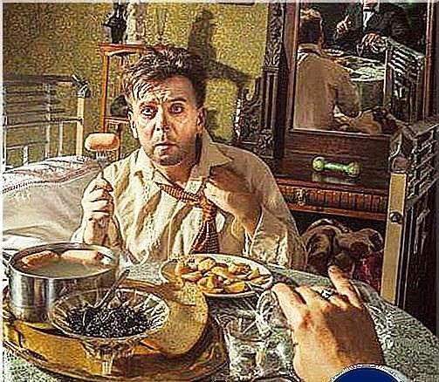
WHO MAKES WRITTEN PACTS WITH THE DEVIL?
None of the tragic protagonists actually sign a pact/contract with the Devil (Margarita makes a verbal agreement).
Many of the petty officials and administrators do sign contracts although they don’t realize with whom – the devil gets in via legalities, paperwork, tele-communications, lying, and taking “bribes.”
An example is the Director of the Variety Theater, Styopa Likhodeyev(above) who has signed a contract with Woland to appear at the Variety Theater; another is Nikanor Bosoi, the house committee chairman, who signs a contract with Koroviev for a fee of 5000 rubles to use Apt. 50.

Slide 6
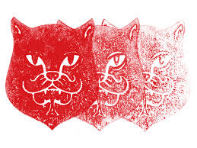
CHAPTER 12 BLACK MAGIC AND ITS EXPOSÉ

Slide 7
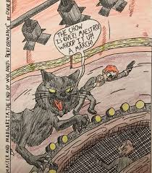
The Magic Show reveals the “lesson” taught by Bulgakov’s satire: the absurdity of rationalizing everything, even magic; magic that is explained is no longer magic. The same holds true for the existence of Satan. Reason applied to the irrational yields nothing (i.e. the Devil).

Slide 8
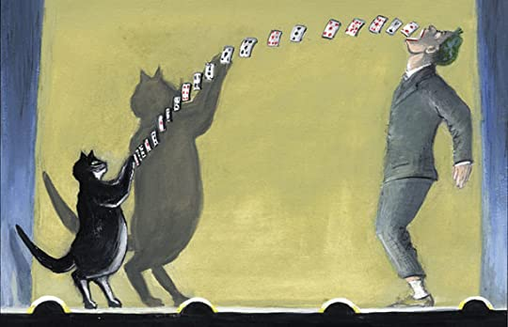
The magic show takes us through Woland’s satiric repertory
FROM STANDARD HARMLESS TRICKS

Slide 9
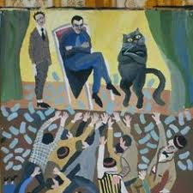
TO
P
R
E
Y
I
N
G
ON
P
E
O
P
L
E
’S
GR
E
E
D

Slide 10
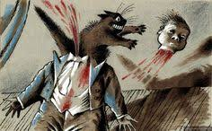
AND THEIR THOUGHTLESSNESS
WHAT IS YOUR COMMAND, MESSIRE? (Should we put the emcee’s head back on or not?)

Slide 11
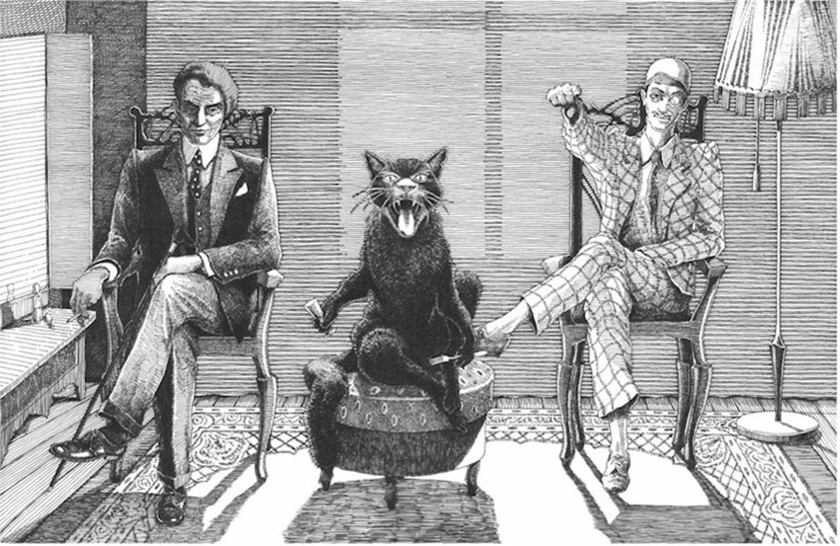
WHAT IS YOUR COMMAND, MESSIRE? (Should we put the emcee’s head back on or not?)
“Well, they are like people anywhere. They love money, but that has always been true… And they are thoughtless…but, then again, sometimes mercy enters their hearts…they are ordinary people…They remind me of their predecessors…only the housing shortage has had a bad effect on them… Put his head back on.”

Slide 12
FOCUS OF BULGAKOV’S COMIC SOCIAL SATIRE
Soviet officialdom/bureaucracy/administration in the theater and literary worlds of the 1930’s
Because Bulgakov’s satire of Soviet bureaucracy in the 1930s is culturally specific, while Bulgakov’s moral satire, is universal. In our course, you should focus on ONLY the moral satire.
Bulgakov used social satire vengefully, to get back at his enemies in the theater and literary establishments.
He kept an enemies’ list. Most of the satirized characters in the novel have real-life prototypes.
The chart that follows sums up the use of satire in M&M.

Slide 13
CHAPTER & PLACE | SINNER | SIN/VICE | PUNISHMENT
Chapter 1, 3 Moscow | Berlioz | Denial of Satan, Jesus | Death and non-being
Chapter 1, 3-6,8, 11, 13 Moscow | Ivan (Bezdomny) | Denial of Satan | “Schizophrenia,” becomes a believer who no one believes; moves on to a new life.
Chapter 2, 25, 26,32 Yershalayim & eternity | Pontius Pilate | Cowardice; pride; anger; covetousness | Hellish pain (migraine); suicidal thoughts; powerless rage; guilt that lasts a thousand years; In the end he is released
Chapter 2, 25 Yershalayim | Juda of Kerioth | Informing (betrayal); avarice | Murdered by the secret police
Chapter 2 Yershalayim | Kaifa and Sinhedrion | Condemn a harmless visionary to death for their own political reasons | (Not stated in the novel, except in Pilate’s threat)
Chapter 13, 29-32,Moscow and eternity | Master, learned historian who wins 100,000, quits his job in order to write a novel, which he burns. | Pride, lust, covetousness, cowardice | Goes mad, loses his identity, kills his creation, abandons his lover.
Chapter 13 & 19-0n, Moscow & eternity | Margarita, elite Moscow wife; adulteress, lover of master | Lust, lying, abandoning her lover at a crucial moment | Loses the love of her life & is forced to deal with the devil to get him back.

Slide 14
CHAPTER & PLACE | SINNER | SIN/VICE | PUNISHMENT
Chapter 7 Moscow | Likhodeev (Styopa), director of the Variety Theater | Sloth, dereliction of duty, gluttony, lust | Signs a contract with the Devil and is spirited out of Moscow.
Chapter 9,15, Moscow | Bosoi (Nikanor Ivanovich), chairman of the house committee | Covetousness, envy, bribe-taking, officiousness | Caught by secret police with foreign currency, arrested, goes mad.
Chapter 10, 14, Moscow | Rimsky, financial director of Variety Theater | Tries to denounce Styopa to secret police; envy; anger | Given the fright of his life, flees to Leningrad, ultimately arrested.
Chapter 10, 14, Moscow | Varenukha, theater manager | Congenital liar; fails to heed warning not to go to the secret police | Beaten up; turned into a vampire for a short time.
Chapter 17, Moscow | Prokhor Petrovich, chairman of the entertainment commission | Anger; insults Behemoth; has no time for anyone; faceless bureaucrat | Turned into a writing suit
Chapter 18, Moscow | Poplavsky, Berlioz’s uncle from Kiev | Covetousness; envy | Sent flying back to Kiev after a beating
Chapter 18, Moscow | Andrei Fokich, bartender at Variety | Hoarder and complainer; self-righteous; sells 2nd grade fresh sturgeon | Learns he will die of cancer in 9 months.

Slide 15
